Slide 1
Israel, Current Events, and Eschatology Part I
Who is Israel?

Slide 2
Introduction
Who Is Israel?
What is their significance to us?

Slide 3
Tracing God’s Special People Through the Word of God
There are three biblical terms associated with who we call the nation of Israel today:
Hebrew
Israel
Jews

Slide 4
Biblical Terms
Genesis 14:13- Hebrew – Revelation 16:16
Genesis 32:28- Israel – Revelation 21:12
II Kings 16:6(s) - Jew – Revelation 3:9

Slide 5
‘Hebrew’ in the O.T.

Slide 6
Adam
Cain
Abel
Seth
Other Sons and Daughters
Enoch
Enos
Irad
Cainan
Mehujael
Mahalaleel
Methusael
Jared
Lamech
Enoch
Jubal
Jabal
Naamah
Tubal-Cain
Methuselah
Lamech
Noah and Sons

Slide 7
Noah
Japheth
Shem
Ham
Eber
All Nations

Slide 8
Genesis 10:21“21 Unto Shem also, the father of all the children of Eber, the brother of Japheth the elder, even to him were children born.”
‌

Slide 9
Luke 3:36 “36 Which was the son of Cainan, which was the son of Arphaxad, which was the son of Sem, which was the son of Noe, which was the son of Lamech,”
‌

Slide 10
Genesis 39:14 “14 That she called unto the men of her house, and spake unto them, saying, See, he hath brought in an Hebrew unto us to mock us; he came in unto me to lie with me, and I cried with a loud voice:”

Slide 11
‘Hebrew’ in the N.T. The majority of NT references have to do with language when used in singular and in the plural (Hebrews) have to do with nationality.

Slide 12
2nd Term – ‘Israel’

Slide 13
The terms Israel and Israelite are referenced more than any other term for this chosen people used in the Bible. (2576 matches - Israel) Hebrew (26 times) Hebrews (22 times) = 48 times ‌Jew (32 times) Jews (257 times) = 289 times ‌Israel (2576 times) Israelite (4 times) = 2580 times

Slide 14
Israel as defined by God’s Word as ‘Prince with God.’
Genesis 32:28 “And he said, Thy name shall be called no more Jacob, but Israel: for as a prince hast thou power with God and with men, and hast prevailed.”
It is a compound of two words ‘power as a prince’ (שׂרה - śârâh) and ‘God.’ (אֵל - el)

Slide 15
Abraham → Isaac→ Jacob (Israel)
There are about 29 different lists of the tribes of Israel.
Believe it or not there is actually 14 reckoned, though 12 are listed. Levi often is omitted. Remember Ephraim and Manasseh were reckoned to Israel because of Joseph. But original heads there are twelve.
1 Reuben
2 Simeon
3 Levi
4 Judah
5 Zebulun
6 Issachar
7 Dan
8 Gad
9 Asher
10 Naphtali
11 Joseph
12 Benjamin
Manasseh
Ephraim

Slide 16
When we get into the opening chapters of Exodus, this is the name in which the people are referenced.
‌Significantly, God calls them the children of Israel in Exodus 3:14 in connection with His eternal name I AM.
‌Exodus 3:14 “14 And God said unto Moses, I AM THAT I AM: and he said, Thus shalt thou say unto the children of Israel, I AM hath sent me unto you.”

Slide 17
That brings us to question that we must address at this juncture, Why is there such importance placed on Israel?
The most direct and fundamental answer is: Because God has placed an importance on Israel.

Slide 18
The Covenant God Made With Abraham
Genesis 12:1-3 “1 Now the Lord had said unto Abram, Get thee out of thy country, and from thy kindred, and from thy father’s house, unto a land that I will shew thee: 2 And I will make of thee a great nation, and I will bless thee, and make thy name great; and thou shalt be a blessing: 3 And I will bless them that bless thee, and curse him that curseth thee: and in thee shall all families of the earth be blessed.”

Slide 19
“ I Will” statements of this covenant.
“...a land that I will shew thee...” vs. 1
‌“...I will make of thee a great nation...”
‌“...I will bless thee...”
‌“...I will bless them that bless thee, and curse him that curseth thee...”
‌“...in thee shall families of the earth be blessed.”

Slide 20
The confirmation of the covenant:
Genesis 13:15“15 For all the land which thou seest, to thee will I give it, and to thy seed for ever.”
Genesis 13:16
“16 And I will make thy seed as the dust of the earth: so that if a man can number the dust of the earth, then shall thy seed also be numbered.”

Slide 21
Genesis 15:
Abraham’s seed should be as the stars of heaven in number. vs. 5
Abraham was given land to be possessed. vs. 7
‌Abraham was given the timing of His seed’s captivity and their exodus. vs 13-14
‌Abraham was given the broad boarders of the land.
vs 18 (See Map)

Slide 23
Genesis 17:8 “8 And I will give unto thee, and to thy seed after thee, the land wherein thou art a stranger, all the land of Canaan, for an everlasting possession; and I will be their God.”

Slide 24
God’s promises to Abraham are:
Personal
National
Universal

Slide 25
The Covenant God made with David
God made a covenant with David in II Samuel 7, it restated in I Chronicles 17:11-14 and II Chronicles 6:16.
God’s covenant like the Abrahamic covenant is unconditional.

Slide 26
God’s Covenant With David
Key Notes of the Davidic Covenant are:
Abrahamic land covenant is repeated. (Israel will be planted and protected. II Samuel 7:10)
A everlasting throne and kingdom.
(II Samuel 7:12-13,16)
This of course will be realized in the reign of Jesus Christ during the Millennial Reign.

Slide 27
God’s Covenant With David
Charles Ryrie in His well respected Basic Theology stated, “The chief characteristics of this kingdom in the conception of the Jewish people were that it would be (a) earthly (b) national (c) Messianic (d) moral and (e) future. This meant (a) on this earth, (b) specifically related to the nation of Israel (d) with high, God-given standards, and (e) not yet in existence.

Slide 28
The Divided Kingdom
Because of this fracture the northern kingdom is referred to often as Israel and sometimes Ephraim. Whereas the southern kingdom is referred to as Judah.
‌(In spite of this, I want you to understand that God has not lost sight of His people ---even the supposed 10 lost tribes.)

Slide 29
3rd Term “Jew”

Slide 30
1/3 of all the references to the term Jew are found in the O.T. and 2/3 are found in the N.T.
The term Jew is derived from the Judah --- meaning ‘belonging to Judah or of Judah’, the Southern Kingdom, but would come to be synonymous with the term Israel.

Slide 31
Snapshot of the O.T and God’s People
God creates, Man falls, Man rebels. God provides and promises. (Genesis 3:15, 20-21)
Man is destroyed save Noah and his family. God calls Abram. (Genesis 6-12)

Slide 32
Snapshot of the O.T and God’s People
3. God promises Abram a name, a land, and a people. (Genesis 12, 15)
4. Israel comes out of Egypt a nation - a great people.

Slide 33
Snapshot of the O.T and God’s People
5. Israel wanders and enters the promised land a Theocracy. (God is their King (God is their King. See Joshua)
6. Israel fails to destroy all the inhabitants. (See end of Joshua, Judges, Ruth, and I Samuel.)

Slide 34
Snapshot of the O.T and God’s People
7. Israel rejects God’s rule and seeks a Monarchy (I Samuel 8:6-7) (See
I Samuel – I Kings)
8. Israel has 3 kings and fractures. (See I Kings 11)

Slide 35
Snapshot of the O.T and God’s People
9. The Northern Kingdom goes into captivity (722 BC).
10. The Southern Kingdom goes into captivity. (605-586 BC)
From this point forward Israel is occupied. (Their sovereignty does not exist until 1948.– 2534 years…

Slide 36
Snapshot of the O.T and God’s People
11. Daniel receives the “kingdom’s vision” and the “70 weeks vision” while Israel is in captivity.
12. Israel returns from captivity to rebuild the temple. (See Ezra)
13. Israel returns and rebuilds the walls. (See Nehemiah.)

Slide 37
Snapshot of the O.T and God’s People
Daniel’s 1st vision (Daniel 2) describes a succession of world kingdoms:

Slide 39
When we arrive in the New Testament we see all three terms used and the term Jew(s) being used the most. (Hebrew 15, Israel 75 times, Jew 197 times).

Slide 40
During the time of Christ, we see God’s people the nation of Israel and the 1st Advent of the Lord Jesus Christ.
In the Gospel records we read of the Lord Jesus Christ being presented as the awaited Messiah and rightful King of Israel. He is rejected by the Jews.

Slide 41
The 70 Weeks Vision

Slide 42
70 Weeks Vision
Daniel 9:24 “24 Seventy weeks are determined upon thy people and upon thy holy city, to finish the transgression, and to make an end of sins, and to make reconciliation for iniquity, and to bring in everlasting righteousness, and to seal up the vision and prophecy, and to anoint the most Holy.”

Slide 43
Daniel 9:25“25 Know therefore and understand, that from the going forth of the commandment to restore and to build Jerusalem [Ezra 1]unto the Messiah the Prince shall be seven weeks¹, and threescore and two weeks²: the street shall be built again, and the wall, even in troublous times.”
‌
7 weeks¹ + 62 weeks² = 69 weeks
(69 – 7’s or 483 years)

Slide 44
Daniel 9:26 “26 And after threescore and two weeks shall Messiah be cut off, but not for himself: and the people of the prince that shall come shall destroy the city and the sanctuary; and the end thereof shall be with a flood, and unto the end of the war desolations are determined.”
‌
After the 69th week the Messiah
shall be cut off.

Slide 45
The main points of the prophecy are this:
‌Daniels 70 weeks are years. (490 total) literally 7-7’s
‌2. They first section spans from decree to rebuild till the Messiah is cut-off. (483 years).
‌3. The remaining 7 years are suspended for the “church age.” As is stated in Romans 9-11.

Slide 46
The main points of the prophecy are this:
4. The remaining 7 years are the 70th week which begins with a peace covenant. (Verse 27)
5. Then in the midst of the week (3.5 years), He will break the covenant and declare Himself god. (See Matthew 24:15-21)

Slide 47
God’s Pause For Israel
Romans chapters 9, 10, and all 11 deal with Israel’s past failures (9) their present calamity (10) and their future salvation (11).
Romans 11:1 “1 I say then, Hath God cast away his people? [who are His people referred to here? Israel.] God forbid. For I also am an Israelite, of the seed of Abraham, of the tribe of Benjamin.”

Slide 48
Romans 11:25-29 “25 For I would not, brethren, that ye should be ignorant of this mystery, lest ye should be wise in your own conceits; that blindness in part is happened to Israel, until the fulness of the Gentiles be come in. 26 And so all Israel shall be saved: as it is written, There shall come out of Sion the Deliverer, and shall turn away ungodliness from Jacob: 27 For this is my covenant unto them, when I shall take away their sins. 28 As concerning the gospel, they are enemies for your sakes: but as touching the election, they are beloved for the fathers’ sakes.”

Slide 49
Romans 11:29 “29 For the gifts and calling of God are without repentance.”
Israel is blinded in part until the fulness of the Gentiles has come in.
Clearly from this passage it will be noted
that this is for a period of time.

Slide 50
Israel, Current Events, and Eschatology Part II
Who is Israel?

Slide 51
Introduction: This morning we looked at the biblical history concerning the nation of Israel. When we move through the historical records of the New Testament the focus shifts from the nation of Israel to the church. Prophetically in the N.T. the focus is on Israel!

Slide 52
Acts 1:6-7 “6 When they therefore were come together, they asked of him, saying, Lord, wilt thou at this time restore again the kingdom to Israel? 7 And he said unto them, It is not for you to know the times or the seasons, which the Father hath put in his own power.”

Slide 53
These are just a few verses that express the importance of the nation of Israel to God:
Deuteronomy 7:6-8
Deuteronomy 32:9-10
Jeremiah 31:35-37
Zechariah 2:8

Slide 54
What is Israel’s History beyond the historical records of the Bible?

Slide 55
Matthew 24:1-2 “1 And Jesus went out, and departed from the temple: and his disciples came to him for to shew him the buildings of the temple. 2 And Jesus said unto them, See ye not all these things? verily I say unto you, There shall not be left here one stone upon another, that shall not be thrown down.”

Slide 56
The Destruction of 70 AD

Slide 57
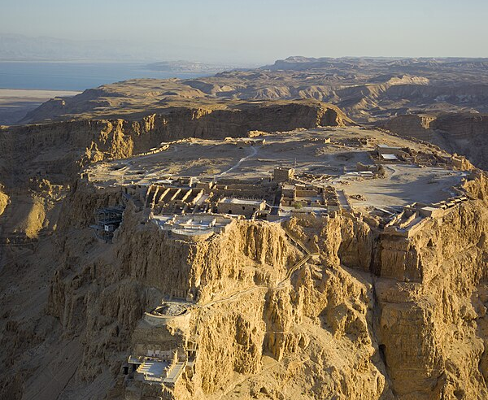

Slide 58
The next important date is in AD 132-136. This is referred to as the Bar Kokbha Revolt.
“Simon bar Kokhba was hailed as a messianic figure, who could bring freedom to Jerusalem. Rome sent six full legions to destroy his movement. As a result of the Bar Kokhba Revolt, all Jews were banned from the city of Jerusalem.”

Slide 59
“After stamping out the province of Judea's second insurrection, the Romans renamed the province Syria Palaestina—that is, “Palestinian Syria.” They did so resentfully, as a punishment, to obliterate the link between the Jews (in Hebrew, Y'hudim and in Latin Judaei) and the province”

Slide 60
In 312 AD following historically some intense periods of persecution for Christians, Roman Emperor Constantine embraces Christianity.
‌In 315 AD “Code of Constantine limits rights of non-Christians, is Constantine's first anti-Jewish act.”

Slide 61
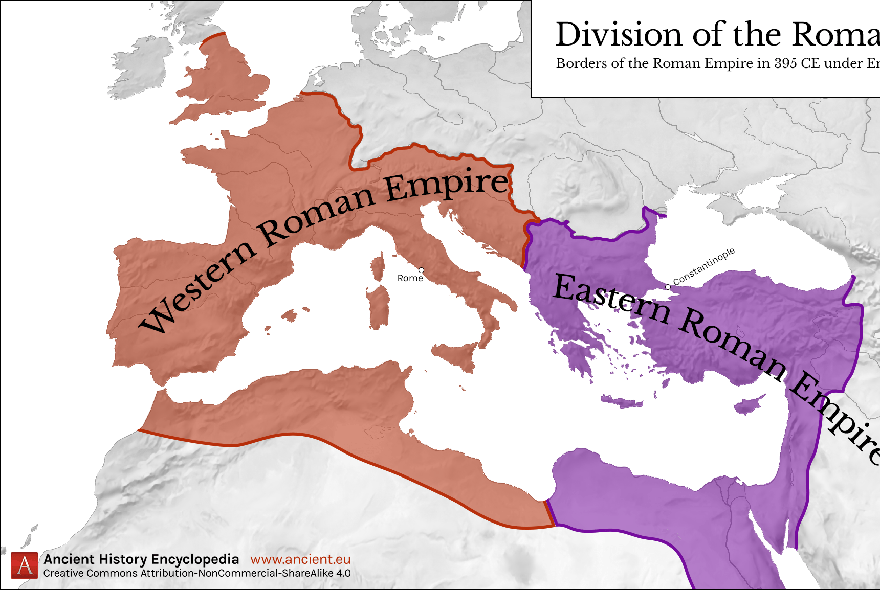
“In the 4th century, the Roman Empire split and Palestine came under the control of the Byzantine Empire.” It was called such because of the moving of the Empire’s throne from Rome to Byzantium (Modern Day Istanbul).”

Slide 62
Byzantine Rule
World
War I
Roman Rule
Crusaders
Rule
Early Muslim
Ottoman
Empire
Mameluke
Empire

Slide 63
Why is there such unrest today?

Slide 64
The dissolution of the Ottoman Empire at the end of WWI (1914-1918).

Slide 65
Just prior to this time a man by the name of Theodore Herzl who was instrumental in organizing what is called the Zionist Congress which would seek diplomatic support for a Jewish country.

Slide 66
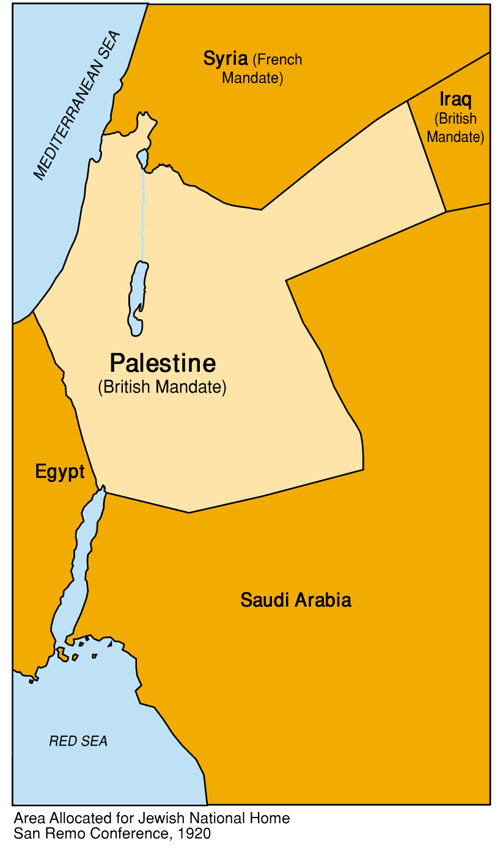

Slide 67
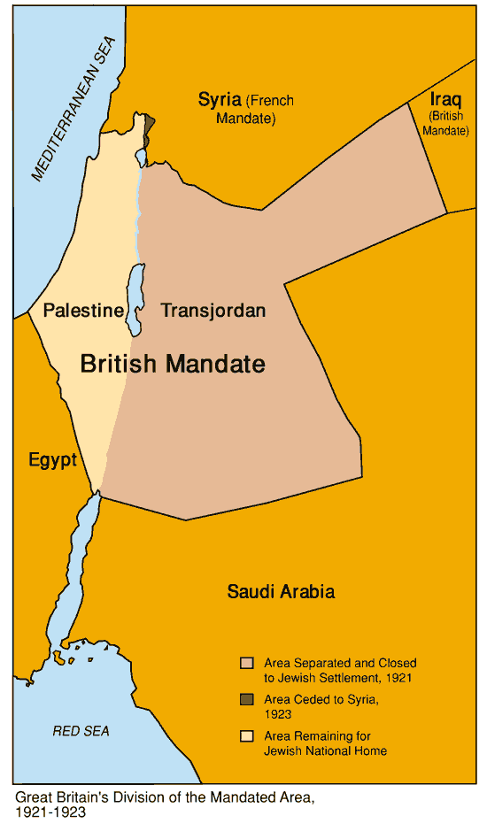
In 1922 because of uprisings and difficulties, the British who have control of this area chop off what they would call Trans-Jordan for the Arab people.
‌

Slide 68
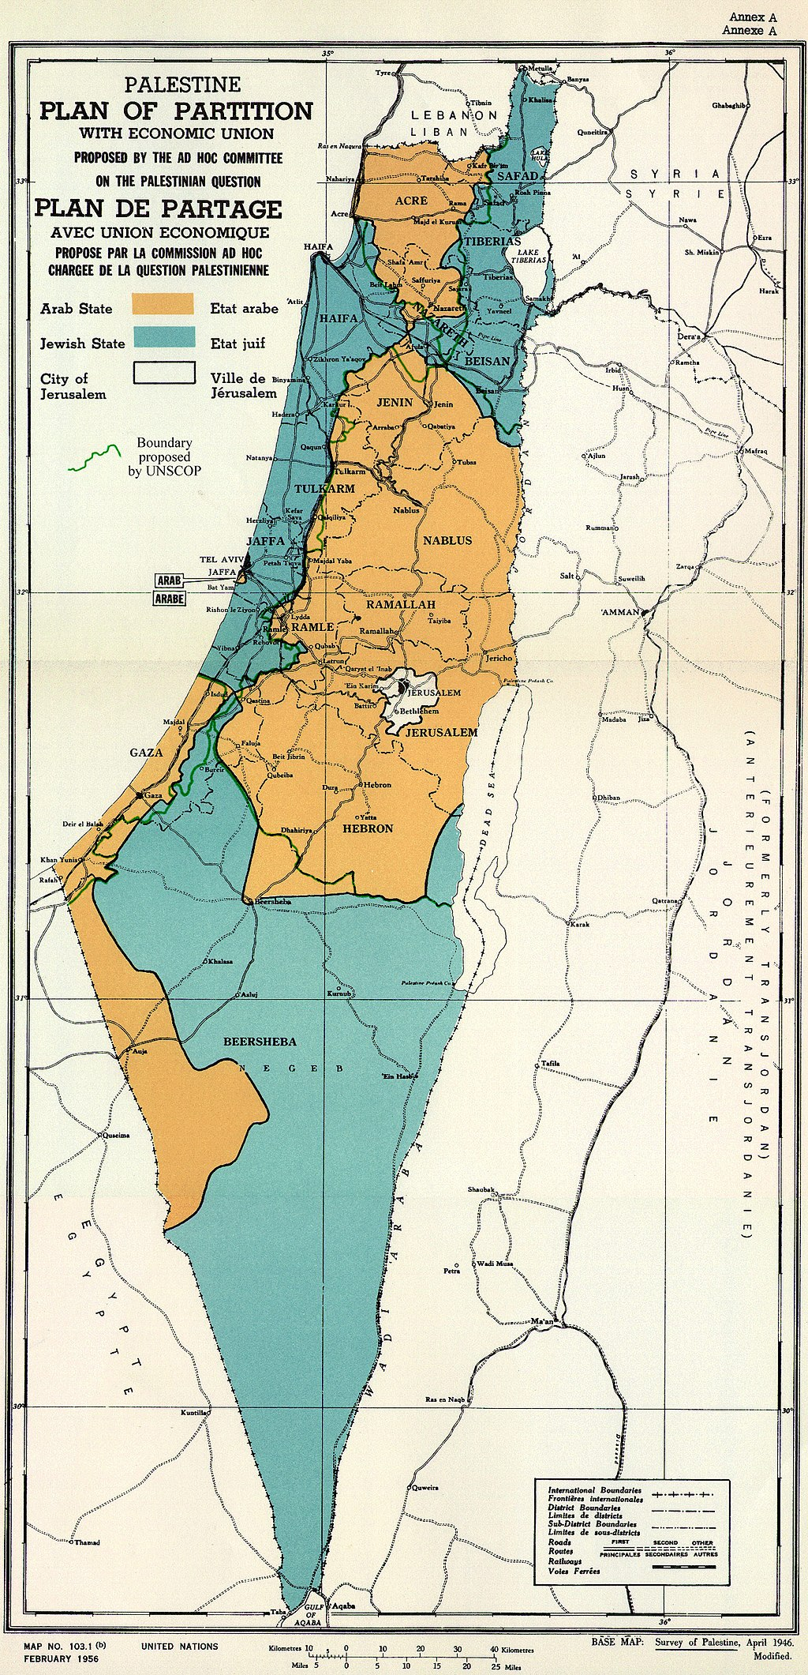
1947 United Nations Partition Plan

Slide 69
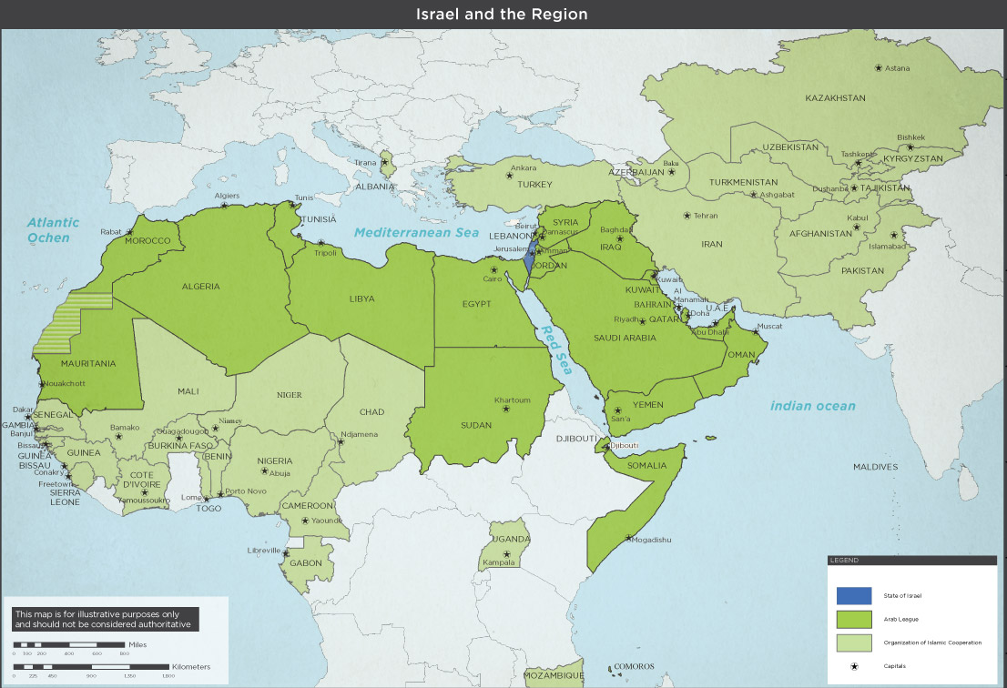

Slide 70
Israel’s Regathering From Prophecy
The prophets spoke of Israel’s regathering.
There will be a future spiritual awakening of the nation of Israel.
The land was promised to be fully possessed and in peace.
The peace covenant made by the Antichrist is with a sovereign Israel.
The defilement of the Temple and the Antichrist’s declaration as god presupposes the reconstitution of Israel and the rebuilding of the temple.

