Slide 1
Convincing the lost
Useful apologetics
SHARON BAPTIST CHURCH

Slide 2
What we will cover
The Biblical Foundation
The Two Main Ideas
Common Question with Biblical Answers
How can you prove God exists?
Does Suffering prove God does not exist?
How do you know the Bible is true?
Did Jesus really rise from the dead?
Why should I believe in Heaven and Hell?
If God created everything did he create evil?
Can all roads lead to Heaven?

Slide 3
The Biblical foundation
The Examples in the Bible
‘reasoned’ - διαλέγομαι, dialegomai - To mingle thought with thought.
Acts 17: 2,3; Acts 18:4; Acts 18:19; Acts 24:25
‘my defence,’ ‘mine answer,’ ‘the defence of the gospel,’ ‘my answer,’ ‘to give an answer’

Slide 4
The biblical foundation
ἀπολογία, apologia - A reasoned statement or argument.
Acts 22:1; I Corinthians 9:3; Philippians 1:7, 1:16,17; II Timothy 4:16, I Peter 3:15

Slide 5
The biblical foundation
Because we are commanded to.
Because the Bible is full of examples where Christians contended for the faith.
Because real people have real questions that do have answers.
Because God does not expect people to have blind faith.
Because we desire to convince the lost.

Slide 6
The biblical foundation
Two Categories of Apologetics:
Academic
Useful
Luke 12:48
Ephesians 5: 15-17

Slide 7
The biblical foundation
“As biblical illiteracy increases in our churches and as authority of any kind-including biblical authority- is more frequently called into question, we will continue to see relativism, skepticism, and smorgasbord religion appear in various “Christian” settings.”
Copan, Paul. That's Just Your Interpretation: Responding to Skeptics Who Challenge Your Faith. Grand Rapids: Baker Books , 2001.

Slide 8
The biblical foundation
The Goal
Our goal is to present arguments without being argumentative. Present a defense without becoming defensive. This will require us to speak the truth in love. (Ephesians 4:15)

Slide 9
The two “main” ideas
God exists
or
God does not exist

Slide 10
The two “main” ideas
Worldview defined:
“is how someone views or interprets reality. It is the framework by which one makes sense of the data of life.”
“Worldview” pg. 785 Geisler, Norman. Baker Encyclopedia of Christian Apologetics. Grand Rapids: Baker Books, 1999.

Slide 11
The two “main” ideas
If I go to the store and run into someone who needs to hear the Gospel. I present the Gospel to them and they get saved, my worldview dictates that God directed my path (Monotheism, Christianity). A naturalist (Atheist, Humanist) would say 1. It was just by chance that you ran into someone and 2. That you presented a philosophy of life to someone who is scared of life and therefore needs a crutch to cope with life.

Slide 12
The two “main” ideas
God Exists (Belief Structures):
Monotheism – One God.
Polytheism – Many Gods.
Pantheism – Everything is God or We all make up God.

Slide 13
The two “main” ideas
God Does Not Exist:
Atheism – ‘A’ – without or no, ‘theism’ – God.
Agnosticism – Is a weak form of Atheism. It is the “I don’t know what to believe” position. It is trying to straddle the road between ‘God exists’ and ‘God does not exist.’

Slide 14
The two “main” ideas
Let’s play a game.
Name the category – God exists or God does not exist.

Slide 15
The two “main” ideas
God exists or God does not exist.
Christianity
God exists

Slide 16
The two “main” ideas
God exists or God does not exist.
Islam
God exists

Slide 17
The two “main” ideas
God exists or God does not exist.
God does
not exist
Secularism

Slide 18
The two “main” ideas
God exists or God does not exist.
God does
not exist
Marxism

Slide 19
The two “main” ideas
God exists or God does not exist.
New Spirituality
God exists

Slide 20
The two “main” ideas
God exists or God does not exist.
God does
Not exist
Postmodernism

Slide 21
The two “main” ideas
For those who believe – No God exists. We start with proving the existence of God.

Slide 22
The two “main” ideas
For those who believe – God exists. We start by assessing what they believe about God. Then we move onto proving the God of the Bible is the one true God.

Slide 23
The two “main” ideas
In all cases, idolatry is the problem. Whether the god created is a false “religious” god or they are the god.

Slide 24
The two “main” ideas
Two Systems of Reconciliation:
By Works
All other “religions”
By Grace
Romans 11:6

Slide 25
The two “main” ideas
Biblical example - Acts 17:22-33
Paul observes what the Athenians believed.
Paul reiterates what they believe about God referencing their altar and poet.
Paul takes them to the Bible.

Slide 26
Common Questions with Biblical Answers
How can you prove God exists?

Slide 27
Common Questions with Biblical Answers
Argument I (Cosmological)

Slide 28
Common Questions with Biblical Answers
Cosmological Argument
Premise I

Slide 29
Common Questions with Biblical Answers
Cosmological Argument
Everything that exists has an explanation of its existence, either in the necessity of its nature or in some external cause.

Slide 30
Common Questions with Biblical Answers
Cosmological Argument
Biblical Basis –
Romans 1:20
Psalm 19

Slide 31
Common Questions with Biblical Answers
Cosmological Argument
Example: If you were hiking and came across a translucent ball lying in the midst of a forest, everyone would agree that it got there somehow. If that ball were the size of a car, would you say it just exists? Would if it were the size of a planet?

Slide 32
Common Questions with Biblical Answers
Cosmological Argument
Premise II

Slide 33
Common Questions with Biblical Answers
Cosmological Argument
If the universe has an explanation of its existence, that explanation is God.

Slide 34
Common Questions with Biblical Answers
Cosmological Argument
Example: Evolution is an example of an impossibility because it tries to surmise an explanation of existence that has to have a beginning. Count back from Man to what? Count back from Universe to what?

Slide 35
Common Questions with Biblical Answers
Cosmological Argument
Do we have scientific reasons to believe that the universe began?

Slide 36
Common Questions with Biblical Answers
Cosmological Argument
Scientific Reasons to believe the Universe began
Expansion of the Universe – Increasing outward in all directions. The reverse would necessitate a start point.

Slide 37
Common Questions with Biblical Answers
Cosmological Argument
The Thermodynamics of the Universe – Energy is tending toward disorder. This presupposes that we are moving away from an orderly state of usable energy. IF there was an infinite past, we would be in a state of equilibrium.

Slide 38
Common Questions with Biblical Answers
Teleological (Design) Argument
Argument II (Teleological/Design)

Slide 39
Common Questions with Biblical Answers
Teleological (Design) Argument
Instead at looking at the origin this looks at the reason behind its function.

Slide 40
Common Questions with Biblical Answers
Teleological (Design) Argument
Teleology - Teleology or finality is a reason or explanation for something in function of its end, purpose, or goal. It is derived from two Greek words: telos (end, goal, purpose) and logos (reason, explanation).

Slide 41
Common Questions with Biblical Answers
Teleological (Design) Argument
Premise I

Slide 42
Common Questions with Biblical Answers
Teleological (Design) Argument
Fine tuning found in the universe is due to either physical necessity, chance, or design.

Slide 43
Common Questions with Biblical Answers
Teleological (Design) Argument
Three Options
Physical Necessity
Chance
Design

Slide 44
Common Questions with Biblical Answers
Teleological (Design) Argument
Bible Basis for Design
John 1:3
Hebrews 1:2,3
Hebrews 3:4
Isaiah 44:24
Isaiah 48:13

Slide 45
Common Questions with Biblical Answers
Teleological (Design) Argument
What about by chance?
Robert Penrose (English mathematical physicist, Oxford University) – current state existing by chance is on the order of 1 chance out of 10¹⁰⁽¹²³⁾. (Not feasible)

Slide 46
Common Questions with Biblical Answers
Teleological (Design) Argument
What about by chance?
“The fine-tuning here is beyond comprehension. Having an accuracy of even 1 part out of 10⁶⁰ is like firing a bullet toward the other side of the observable universe, twenty billion light-years away, and nailing a one-inch target!”

Slide 47
Common Questions with Biblical Answers
Teleological (Design) Argument
What about by physical necessity?
Evidence abounds where there is no observable life. Therefore, it is far more probable a universe will be life-prohibiting than it would be life-permitting.

Slide 48
Common Questions with Biblical Answers
Teleological (Design) Argument
Premise II

Slide 49
Common Questions with Biblical Answers
Teleological (Design) Argument
Fine Tuning Is Not By Chance Nor By Necessity

Slide 50
Common Questions with Biblical Answers
Teleological (Design) Argument
Premise III

Slide 51
Common Questions with Biblical Answers
Teleological (Design) Argument
Fine Tuning Is Due To Design

Slide 52
Common Questions with Biblical Answers
Teleological (Design) Argument
But how can you know there is a God? He is not tangible?

Slide 53
Common Questions with Biblical Answers
Teleological (Design) Argument
Can we think of anything that exists without being tangible?
Air
Gravity
Mathematics
Love

Slide 54
Common Questions with Biblical Answers
Teleological (Design) Argument
What about history you were taught but were not present for?
What about distant planets yet to be discovered?

Slide 55
Common Questions with Biblical Answers
Teleological (Design) Argument
This is a fantastic time to use your personal testimony.
Paul’s example Acts 26:12-16

Slide 56
Common Questions with Biblical Answers
The Moral Argument
Argument III
(The Moral Argument)

Slide 57
Common Questions with Biblical Answers
The Moral Argument
The question is raised, can we be good without God?
Someone who does not believe in the existence of God would espouse relativism.

Slide 58
Common Questions with Biblical Answers
The Moral Argument
Relativism - the doctrine that knowledge, truth, and morality exist in relation to culture, society, or historical context, and are not absolute.

Slide 59
Common Questions with Biblical Answers
The Moral Argument
Premise I

Slide 60
Common Questions with Biblical Answers
The Moral Argument
If God does not exist, objective moral values and duties do not exist.
(This premise seems agreeable to relativists).

Slide 61
Common Questions with Biblical Answers
The Moral Argument
Values -
Something is good or bad.
Duties -
Something is right or wrong. (Moral Obligation)

Slide 62
Common Questions with Biblical Answers
The Moral Argument
Example – It would be good for you to become a doctor but you are not morally obligated to be one.

Slide 63
Common Questions with Biblical Answers
The Moral Argument
Objective Statement – I can say objectively that if you drink strychnine regardless of your opinion of it you will die.

Slide 64
Common Questions with Biblical Answers
The Moral Argument
Restate the Premise– if God does not exist then moral values and duties are not objective.

Slide 65
Common Questions with Biblical Answers
The Moral Argument
The objective in this premise is to show that objective moral values require God.

Slide 66
Common Questions with Biblical Answers
The Moral Argument
What the first premise does not state:

Slide 67
Common Questions with Biblical Answers
The Moral Argument
It does not try to prove that you cannot recognize objective moral values and duties without believing in God.

Slide 68
Common Questions with Biblical Answers
The Moral Argument
It does not try to prove that we cannot form a system of ethics without referring to God.

Slide 69
Common Questions with Biblical Answers
The Moral Argument
“Belief in God is not necessary for objective morality; but God is” necessary for objective morality.
Pg. 135 Craig, William Lane. On Guard. Colorado Springs: David C. Cook, 2010.

Slide 70
Common Questions with Biblical Answers
The Moral Argument
Premise II

Slide 71
Common Questions with Biblical Answers
The Moral Argument
Objective moral values and duties exist.

Slide 72
Common Questions with Biblical Answers
Moral Argument
Bible Basis:
Genesis 1: 26,27
Leviticus 19:2
Exodus 20

Slide 73
Common Questions with Biblical Answers
Moral Argument
Examples to use in discussion with a relativist:
Is it right for me to steal from you?
Is it right for me to murder?
What is the basis for any accountability?

Slide 74
Common Questions with Biblical Answers
Moral Argument
A common statement of a relativist:
“We are just products of our environments and genes.”

Slide 75
Common Questions with Biblical Answers
Moral Argument
“What we call morality is nothing more than an attempt to survive and reproduce. In fact, all that we do is nothing more than our struggle to survive and reproduce.”

Slide 76
Common Questions with Biblical Answers
Moral Argument
Answer: The fallacy is that they believe there is good reason and rationale to hold such a view thereby making themselves the acceptation to their own rule.

Slide 77
Common Questions with Biblical Answers
Moral Argument
Sometimes people will object to the morale argument with this question:
Question: What about the problem of suffering. If God exists why would he allow suffering?

Slide 78
Common Questions with Biblical Answers
Moral Argument
Luke 13: 1-5

Slide 79
Common Questions with Biblical Answers
Moral Argument
Two areas discussion:
The intellectual problem with suffering
The emotional problem with suffering

Slide 80
Common Questions with Biblical Answers
Moral Argument
Dealing with the intellectual problem.
Does suffering prove God does not exist?

Slide 81
Common Questions with Biblical Answers
Moral Argument
Step 1 clarify the argument.

Slide 82
Common Questions with Biblical Answers
Moral Argument
“Are you saying it is impossible for God and suffering to coexist, or are you saying it is improbable that God and suffering both exist?”

Slide 83
Common Questions with Biblical Answers
Moral Argument
Impossible for God and suffering to coexist
1. An all-loving, all-powerful God exists.
2. Suffering exists.
3. Therefore, an all-loving and all-powerful God does not exist otherwise suffering would not exist.

Slide 84
Common Questions with Biblical Answers
Moral Argument
Impossible for God and suffering to coexist
Does man have free will?
What is meant by free-will?

Slide 85
Common Questions with Biblical Answers
Moral Argument
Impossible for God and suffering to coexist
Genesis 2: 15-17

Slide 86
Common Questions with Biblical Answers
Moral Argument
Impossible for God and suffering to coexist
In order for man to have free will, he must have choices. Those choices necessitate right and wrong.

Slide 87
Common Questions with Biblical Answers
Moral Argument
Impossible for God and suffering to coexist
How does free will allow for suffering?
If we choose wrongly suffering takes place.

Slide 88
Common Questions with Biblical Answers
Moral Argument
Impossible for God and suffering to coexist
If a child is kept in a room that has nothing in it, that child cannot burn their hands. They have no option between touching a stove or not touching a stove.

Slide 89
Common Questions with Biblical Answers
Moral Argument
Impossible for God and suffering to coexist
However, if a child is put in a room with a hot stove and explicitly told, do not touch the stove, they have a choice between suffering and non-suffering.

Slide 90
Common Questions with Biblical Answers
Moral Argument
Impossible for God and suffering to coexist
Does this mean that the parent does not love the child, if the parent has told the child not to touch the stove?

Slide 91
Common Questions with Biblical Answers
Moral Argument
Impossible for God and suffering to coexist
Is there a possibility that suffering can bring a greater good?

Slide 92
Common Questions with Biblical Answers
Moral Argument
Impossible for God and suffering to coexist
Romans 5: 3-5
Ephesians 2: 4-7

Slide 93
Common Questions with Biblical Answers
Moral Argument
Impossible for God and suffering to coexist
What is a worldly example of good coming from suffering?

Slide 94
Common Questions with Biblical Answers
Moral Argument
Improbable that God would exist with suffering in the world
But what about it being improbable that God would exist with suffering in the world?

Slide 95
Common Questions with Biblical Answers
Moral Argument
Improbable that God would exist with suffering in the world
First Response:
We are not in a position to say that it is improbable that God does not have good reasons for allowing suffering in the world.

Slide 96
Common Questions with Biblical Answers
Moral Argument

Slide 97
Common Questions with Biblical Answers
Moral Argument
Chaos Theory

Slide 98
Common Questions with Biblical Answers
Moral Argument
Improbable that God would exist with suffering in the world
Second Response:
Considering the full scope of evidence (not just suffering) God’s existence is probable.

Slide 99
Common Questions with Biblical Answers
Moral Argument
Improbable that God would exist with suffering in the world
The Partial Scope of Evidence:
Joe is a college student.
Statistics show that 90% of all college students drink alcohol.
It is probable that Joe drinks alcohol.

Slide 100
Common Questions with Biblical Answers
Moral Argument
Improbable that God would exist with suffering in the world
The Full Scope of Evidence:
Joe is a college student at Wheaton College.
Statistics also show that 90% of all college students that go to Wheaton college do not drink alcohol.
Statistics show that 90% of all college students drink alcohol.
It is probable that Joe does not drink alcohol.

Slide 101
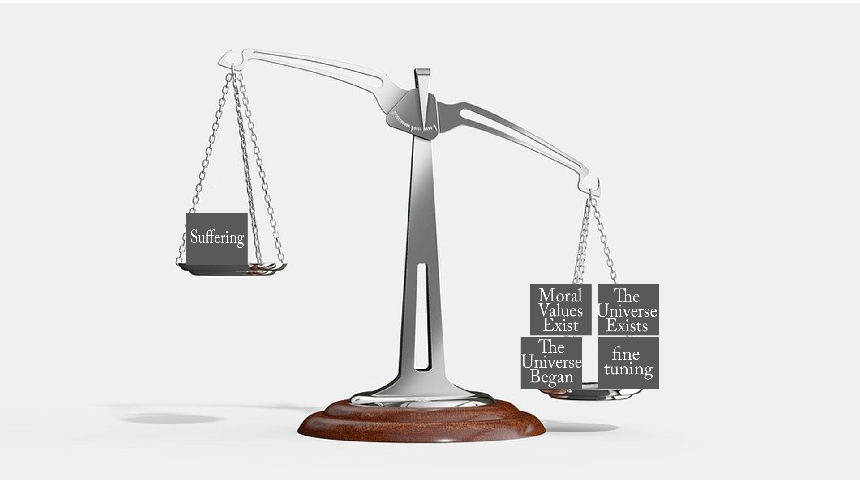
Common Questions with Biblical Answers
Moral Argument

Slide 102
Common Questions with Biblical Answers
Moral Argument
Improbable that God would exist with suffering in the world
Third Response:
Within the framework of Biblical Christianity, non-suffering is not the goal, but rather knowledge of God.

Slide 103
Common Questions with Biblical Answers
Moral Argument
Improbable that God would exist with suffering in the world
“One reason that the problem of suffering seems so puzzling is that people naturally assume that if God exists, then His purpose for human life is happiness in this life.”

Slide 104
Common Questions with Biblical Answers
Moral Argument
Improbable that God would exist with suffering in the world
Because of the fall of man and the presence of sin, God’s plan is redemptive. Knowledge of Him and reconciliation will result in eventual everlasting fulfillment.

Slide 105
Common Questions with Biblical Answers
Moral Argument
Improbable that God would exist with suffering in the world
Leviticus 10: 1-3
Isaiah 49:3
Isaiah 66:5
Luke 23:47
John 11:4
John 17:4

Slide 106
Common Questions with Biblical Answers
Moral Argument
Improbable that God would exist with suffering in the world
Secondly, Within the Christian worldview man is in a state of rebellion against God.

Slide 107
Common Questions with Biblical Answers
Moral Argument
Improbable that God would exist with suffering in the world
John 3: 19-21
Romans 1: 18-25
James 4:4
Romans 8:7

Slide 108
Common Questions with Biblical Answers
Moral Argument
Improbable that God would exist with suffering in the world
Thirdly, according to the Christian worldview man does not cease to exist upon physical death. Therefore, there is more to this life than right now.

Slide 109
Common Questions with Biblical Answers
Moral Argument
Improbable that God would exist with suffering in the world
Romans 8:18
II Corinthians 5: 1-4
Romans 8: 19-23

Slide 110
Common Questions with Biblical Answers
Moral Argument
Improbable that God would exist with suffering in the world
Lastly, knowledge of God and reconciliation to Him far outweighs the sufferings of this present world.
II Corinthians 4: 16-18

Slide 111
Common Questions with Biblical Answers
Moral Argument
What about the emotional problem of suffering?

Slide 112
Common Questions with Biblical Answers
Moral Argument
Intellectual answers do not necessarily deal with the emotional problem of suffering.

Slide 113
Common Questions with Biblical Answers
Moral Argument
1. Most need a loving friend and a ready listener, not an intellectual answer.
2. Unlike other “worldviews” we have real resources to help us in and through suffering, our Savior Jesus Christ!
3. As noted earlier, our knowledge of God is an immeasurable good. It provides purpose and hope that cannot be found elsewhere.

Slide 114
Common Questions with Biblical Answers
Moral Argument
4. Story of Mabel

Slide 115
Common Questions with Biblical Answers
How do you know the Bible is true?

Slide 116
Common Questions with Biblical Answers
How do you know the Bible is true?
Internal Evidence:
What is found in the Bible itself or in
comparison to itself.

Slide 117
Common Questions with Biblical Answers
How do you know the Bible is true?
External Evidence:
What is found outside the Bible from
other sources.

Slide 118
Common Questions with Biblical Answers
How do you know the Bible is true?
What does the internal evidence say?
Facts concerning the Bible

Slide 119
Common Questions with Biblical Answers
How do you know the Bible is true?
1. The Bible is comprised of 66 different books, written by at least 40 different penman and written over a 1500-year period. With such diversity, how can there be a semblance of unity?

Slide 120
Common Questions with Biblical Answers
How do you know the Bible is true?
2. Concerning just the New Testament alone which is comprised of 27 individual books, there was insufficient time to erase core facts. I.E. the so-called “legend hypothesis.”

Slide 121
Common Questions with Biblical Answers
How do you know the Bible is true?
3. The subject matter of the Bible includes embarrassing accounts, which is an evidence of authenticity. This is one criterion of six used to prove authenticity of ancient documents.

Slide 122
Common Questions with Biblical Answers
How do you know the Bible is true?
Name some notable embarrassing passages in the Bible

Slide 123
Common Questions with Biblical Answers
How do you know the Bible is true?
4. Jesus’ own explicit claims. He claimed to be the Son of God. He claimed to be the Messiah. He claimed deity

Slide 124
Common Questions with Biblical Answers
How do you know the Bible is true?
5. Fulfillment of Prophecy. Beside the uncanny unity of the Bible, the fulfillment of prophecy is impossible from mere guesswork.

Slide 125
Common Questions with Biblical Answers
How do you know the Bible is true?
Stoner’s probability quote:
“Multiplying all these probabilities together produces a number (rounded off) of 1×1028. Dividing this number by an estimate of the number of people who have lived since the time of these prophecies (88 billion) produces a probability of all 8 prophecies being fulfilled accidently in the life of one person. That probability is 1 in 1017 or 1 in 100,000,000,000,000,000. That’s one in one hundred quadrillion!”

Slide 126
Common Questions with Biblical Answers
How do you know the Bible is true?
Stoner’s probability quote:
“Multiplying all these probabilities together produces a number (rounded off) of 1×1028. Dividing this number by an estimate of the number of people who have lived since the time of these prophecies (88 billion) produces a probability of all 8 prophecies being fulfilled accidently in the life of one person. That probability is 1 in 1017 or 1 in 100,000,000,000,000,000. That’s one in one hundred quadrillion!”

Slide 127
Common Questions with Biblical Answers
How do you know the Bible is true?
6. Fantastic claims that could be verified.

Slide 128
Common Questions with Biblical Answers
How do you know the Bible is true?
7. The Disciples and early believers’ commitment to the truth. (This is noted both internally and verified with external sources. Most gave their lives for what they believed.)

Slide 129
Common Questions with Biblical Answers
How do you know the Bible is true?
What does the external evidence say?

Slide 130
Common Questions with Biblical Answers
How do you know the Bible is true?
Concerning Historical Accuracy – just the book of Acts alone contains at least 84 precise facts as found by historian and explorer Sir William Ramsey. (See the Evidence to Support the truth for these facts.)

Slide 131
Common Questions with Biblical Answers
How do you know the Bible is true?
Archeological Evidence – There is a vast amount of evidence that supports many different details in the Bible.

Slide 132
Common Questions with Biblical Answers
How do you know the Bible is true?
Early Writings from Other Sources
Tacitus (56-120AD)
Mara Bar-Serapion (70AD)
Pliny the Younger (61-113AD)
Suetonius (69-140AD)
Lucian of Samosata (115-200 A.D.)
Josephus (37-101AD)
Jewish Talmud (400-700AD)
The Toledot Yeshu (1000AD)

Slide 133
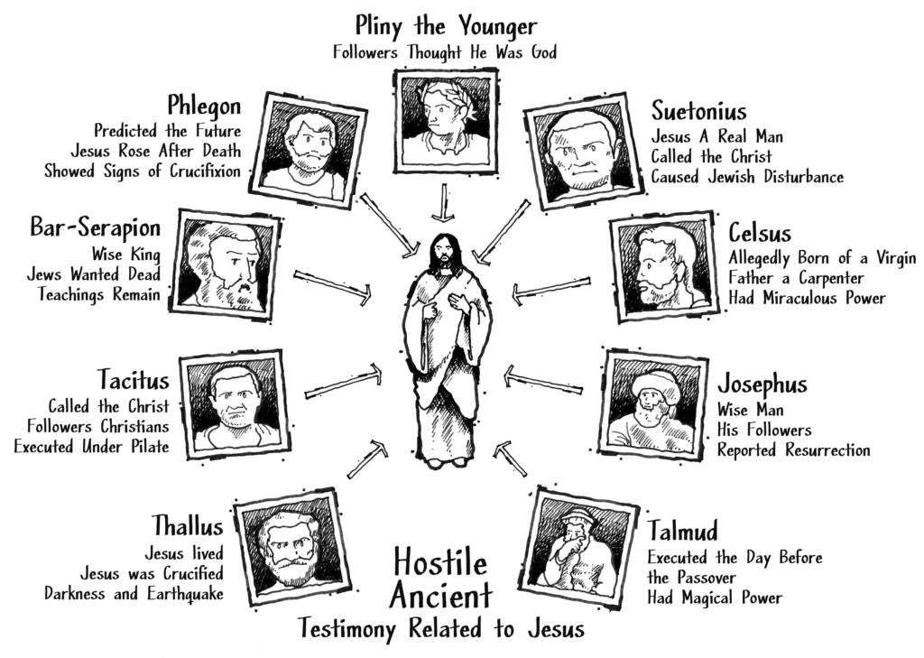
Common Questions with Biblical Answers
How do you know the Bible is true?

Slide 134
Common Questions with Biblical Answers
Did Jesus really rise from the dead?

Slide 135
Common Questions with Biblical Answers
Did Jesus really rise from the dead?
What are some evidences that we can point to or logical arguments?

Slide 136
Common Questions with Biblical Answers
Did Jesus really rise from the dead?
The already established historical reliability of the story of Jesus’ burial must support the empty tomb.

Slide 137
Common Questions with Biblical Answers
Did Jesus really rise from the dead?
The disciples could not have believed in the resurrection of Jesus if the tomb was not empty.

Slide 138
Common Questions with Biblical Answers
Did Jesus really rise from the dead?
2. Even if the disciples did believe despite the fact that Jesus was still in the tomb, nobody would have listened. Since the Gospel proliferated from Jerusalem, there would have been ample evidence for no one to believe.

Slide 139
Common Questions with Biblical Answers
Did Jesus really rise from the dead?
3. The Jewish authorities would have unmasked the false story immediately.

Slide 140
Common Questions with Biblical Answers
Did Jesus really rise from the dead?
4. Joseph of Arimathea a member of the Sanhedrin is unlikely to be a Christian invention. “Given his status as a Sanhedrist, Joseph is the last person you would expect to care properly for Jesus”
Pg. 225 Craig, William Lane. On Guard. Colorado Springs: David C. Cook, 2010.

Slide 141
Common Questions with Biblical Answers
Did Jesus really rise from the dead?
5. Because of the historicity of the Bible, we have specifically four separate sources that indicate Jesus died, was buried, and rose from the grave. And as we continue below the list of independent sources are not limited to just the Gospel records.

Slide 142
Common Questions with Biblical Answers
Did Jesus really rise from the dead?
What about in the Bible?
Paul in I Corinthians 15: 3-5 gives us three keys or proofs to Jesus Christ death, burial and resurrection, that is spoken of by corresponding witnesses. Remember every book in the Bible is considered an independent source document.

Slide 143
Common Questions with Biblical Answers
Did Jesus really rise from the dead?
What about in the Bible?
I Corinthians 15 “…Christ died…”
Acts 13: 28
Mark 15:37

Slide 144
Common Questions with Biblical Answers
Did Jesus really rise from the dead?
What about in the Bible?
I Corinthians 15 “…he was buried…”
Acts 13: 29
Mark 15:45,46

Slide 145
Common Questions with Biblical Answers
Did Jesus really rise from the dead?
What about in the Bible?
I Corinthians 15 “he rose again the third day according to the scriptures:”
Acts 13: 30
Mark 16:5,6

Slide 146
Common Questions with Biblical Answers
Did Jesus really rise from the dead?
What about in the Bible?
I Corinthians 15 “…he appeared…”
Acts 13:31
Mark 16:7

Slide 147
Common Questions with Biblical Answers
Did Jesus really rise from the dead?
Some “theories” of Jesus’ death, burial and resurrection that hold no water.

Slide 148
Common Questions with Biblical Answers
Did Jesus really rise from the dead?
The Swoon Theory
He passed out and the cool air of the tomb woke him up. (He faints before he dies, somehow survives is stolen away or is able to walk out of the tomb.)

Slide 149
Common Questions with Biblical Answers
Did Jesus really rise from the dead?
What are some problems with this theory?

Slide 150
Common Questions with Biblical Answers
Did Jesus really rise from the dead?
The Hallucination Theory
He did not rise from the dead, only people thought they saw him.

Slide 151
Common Questions with Biblical Answers
Did Jesus really rise from the dead?
What are some problems with this theory?

Slide 152
Common Questions with Biblical Answers
Did Jesus really rise from the dead?
The Impersonation Theory
Someone dressed up to be like Jesus but was not Jesus.

Slide 153
Common Questions with Biblical Answers
Did Jesus really rise from the dead?
What are some problems with this theory?

Slide 154
Common Questions with Biblical Answers
Did Jesus really rise from the dead?
The “Spiritual Resurrection” Theory
This is the theory that just Jesus’ spirit arose not his physical body?

Slide 155
Common Questions with Biblical Answers
Did Jesus really rise from the dead?
What are some problems with this theory?

Slide 156
Common Questions with Biblical Answers
Did Jesus really rise from the dead?
The Theft Theory
The disciples came and stole Jesus away.

Slide 157
Common Questions with Biblical Answers
Did Jesus really rise from the dead?
What are some problems with this theory?

Slide 158
Common Questions with Biblical Answers
Did Jesus really rise from the dead?
The Unknown Tomb Theory
This simply states they went to wrong tomb and Jesus’ body was not there.

Slide 159
Common Questions with Biblical Answers
Did Jesus really rise from the dead?
What are some problems with this theory?

Slide 160
Common Questions with Biblical Answers
Why should I believe Heaven and Hell exist?
I don’t believe in an afterlife.

Slide 161
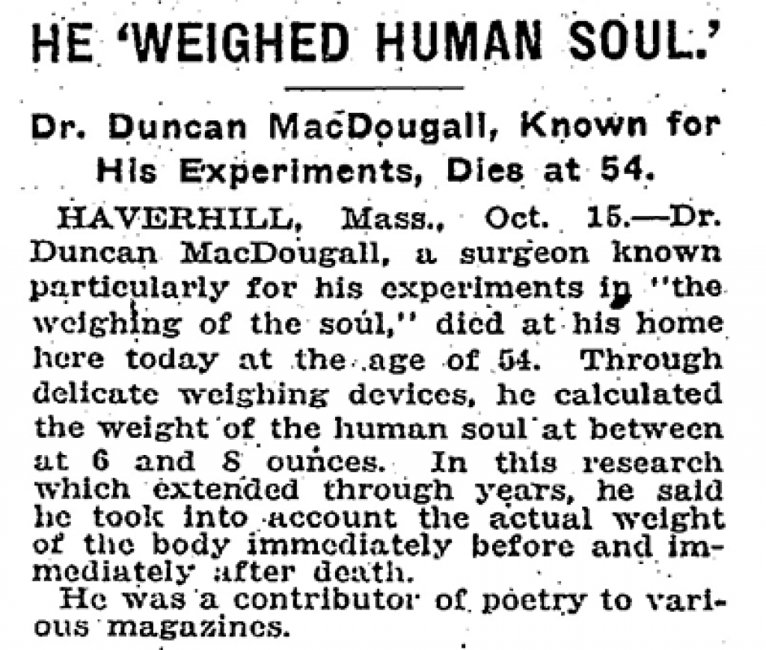
Common Questions with Biblical Answers
Why should I believe Heaven and Hell exist?

Slide 162
Common Questions with Biblical Answers
Why should I believe Heaven and Hell exist?
Premise I

Slide 163
Common Questions with Biblical Answers
Why should I believe Heaven and Hell exist?
There is a universality in ever era and culture of people who have this belief in an afterlife.

Slide 164
Common Questions with Biblical Answers
Why should I believe Heaven and Hell exist?
Does the Bible tell us that man universally holds this belief?

Slide 165
Common Questions with Biblical Answers
Why should I believe Heaven and Hell exist?
He hath made every thing beautiful in his time: also he hath set the world in their heart, so that no man can find out the work that God maketh from the beginning to the end.
Ecclesiastes 3:11

Slide 166
Common Questions with Biblical Answers
Why should I believe Heaven and Hell exist?
The word, translated “world” in the text, and “eternity” in this note, is used seven times in Ecclesiastes.

Slide 167
Common Questions with Biblical Answers
Why should I believe Heaven and Hell exist?
Premise II

Slide 168
Common Questions with Biblical Answers
Why should I believe Heaven and Hell exist?
Just like the moral argument, all of mankind has an innate cry within themselves for justice.

Slide 169
Common Questions with Biblical Answers
Why should I believe Heaven and Hell exist?
Sense of justice built into the brain
by Public Library of Science

Slide 170
Common Questions with Biblical Answers
Why should I believe Heaven and Hell exist?
Premise III

Slide 171
Common Questions with Biblical Answers
Why should I believe Heaven and Hell exist?
Jesus directly taught concerning Heaven and Hell.

Slide 172
Common Questions with Biblical Answers
Why should I believe Heaven and Hell exist?
Is Jesus qualified? Considering the fact of Jesus, being God incarnate, Creator of all things; He has the best perspective on eternity.

Slide 173
Common Questions with Biblical Answers
Why should I believe Heaven and Hell exist?
Matthew 5: 29-30
Matthew 10:28
Matthew 13: 41-43
Matthew 22: 29-32
Matthew 23:33
Matthew 25: 31-34, 41,46
Luke 6: 22,23
Luke 10:15
Luke 10:20
Luke 16: 19-31 *
John 3:13
John 6:38
John 14: 2,3
John 17: 3-5, 24

Slide 174
Common Questions with Biblical Answers
Why should I believe Heaven and Hell exist?
Would God judge man with the sentence of going to Hell?

Slide 175
Common Questions with Biblical Answers
Why should I believe Heaven and Hell exist?
1. God is perfect and as such MUST be a just judge. Therefore, he must condemn sin and not overlook it.
Genesis 18:25
I Samuel 2:10
Romans 2: 1,2

Slide 176
Common Questions with Biblical Answers
Why should I believe Heaven and Hell exist?
God does not owe anyone a second chance and yet he repeatedly extends his mercy and grace toward us and yet people still stubbornly refuse to repent.

Slide 177
Common Questions with Biblical Answers
Why should I believe Heaven and Hell exist?
3. We all have sinned; thus, we have earned the “wages” of sin. We are offered a free gift of Salvation through Jesus Christ our Lord. Those who face judgement will do so because of rejection of Jesus Christ.

Slide 178
Common Questions with Biblical Answers
Why should I believe Heaven and Hell exist?
Secondary Question:
What about those who never have been given the Gospel?

Slide 179
Common Questions with Biblical Answers
Why should I believe Heaven and Hell exist?
We are given the commission to take the Gospel to the ends of the world. (Matthew 28: 18-20)

Slide 180
Common Questions with Biblical Answers
Why should I believe Heaven and Hell exist?
2. God is not obligated to save anyone.

Slide 181
Common Questions with Biblical Answers
Why should I believe Heaven and Hell exist?
3. According to the Bible everyone is culpable because our internal witness (conscience) and our external witness (the heavens and earth.) (Romans 1:19,20 Psalm 19:1-5)

Slide 182
Common Questions with Biblical Answers
Why should I believe Heaven and Hell exist?
4. God declares everyone is responsible for the light they are given. (Luke 12:48) (Matthew 10:15, 11:21-23, 12:41,42) Therefore it is not our responsibility to sort this out, but rather God is the Judge.

Slide 183
Common Questions with Biblical Answers
Why should I believe Heaven and Hell exist?
5. Ephesians 2:8,9, John 1:9 and Titus 2:11 make clear that Salvation is offered to all.

Slide 184
Common Questions with Biblical Answers
If God created everything did he create evil?

Slide 185
Common Questions with Biblical Answers
If God created everything did He create evil?
Isaiah 45:7 “I form the light, and create darkness: I make peace, and create evil: I the LORD do all these things.”

Slide 186
Common Questions with Biblical Answers
If God created everything did He create evil?
Light/Darkness
Peace/Evil (punishment, pestilence etc.…) – God is the judge of all things, the moral lawgiver.

Slide 187
Common Questions with Biblical Answers
If God created everything did He create evil?
The argument normally goes like this:
God created all things and therefore created evil as well.

Slide 188
Common Questions with Biblical Answers
If God created everything did He create evil?
Evil is not a thing to be created, but rather should be looked at as an absence of good or a rejection of good.

Slide 189
Common Questions with Biblical Answers
If God created everything did He create evil?
God is described over and over again as good. He is the standard bearer of right.
Consider the following verses:

Slide 190
Common Questions with Biblical Answers
If God created everything did He create evil?
I Samuel 2:2
I Samuel 6:20
Psalm 99:9
I Corinthians 3:17
Revelation 4:8

Slide 191
Common Questions with Biblical Answers
If God created everything did He create evil?
Because of the nature of free will, God has allowed conditions to exist where evil is a possibility.

Slide 192
Common Questions with Biblical Answers
If God created everything did He create evil?
One of the great purposes of God’s plan is for His glory. We also know that love necessitates the ability to choose.

Slide 193
Common Questions with Biblical Answers
Can all roads lead to Heaven?

Slide 194
Common Questions with Biblical Answers
Can all roads lead to Heaven?
Particularist
Pluralist

Slide 195
Common Questions with Biblical Answers
Can all roads lead to Heaven?
One of the main arguments used against someone who believes Jesus Christ is the only way of Salvation is that of cultural relativity.

Slide 196
Common Questions with Biblical Answers
Can all roads lead to Heaven?
Genetic fallacy - “This is trying to invalidate a position by criticizing the way a person came to hold that position.”
Pg. 270 Craig, William Lane. On Guard. Colorado Springs: David C. Cook, 2010.

Slide 197
Common Questions with Biblical Answers
Can all roads lead to Heaven?
Example: If you were born in Greece and believed therefore that the earth orbits the sun, is there any grounds to dismiss that belief because you were born in Greece?

Slide 198
Common Questions with Biblical Answers
Can all roads lead to Heaven?
First, there are fundamental differences between biblical Christianity and all other religions.

Slide 199
Common Questions with Biblical Answers
Can all roads lead to Heaven?
Second, Biblical Christianity only provides consistent and coherent answers to life’s biggest questions. (Origin, Meaning, Morality, and Destiny.)

Slide 200
Common Questions with Biblical Answers
Can all roads lead to Heaven?
Third, the historicity of Jesus’ death, burial and resurrection agree with the Bible.

Slide 201
Common Questions with Biblical Answers
Can all roads lead to Heaven?
Fourth, Jesus claimed to be the only way of Salvation.

Slide 202
Common Questions with Biblical Answers
Can all roads lead to Heaven?
What are some differences between Christianity and other religions?

Slide 203
Common Questions with Biblical Answers
Can all roads lead to Heaven?
Jesus claimed to be God.

Slide 204
Common Questions with Biblical Answers
Can all roads lead to Heaven?
2. The Bible claims Jesus died for the sins of the world.

Slide 205
Common Questions with Biblical Answers
Can all roads lead to Heaven?
3. The Bible claims Jesus rose from the grave.

Slide 206
Common Questions with Biblical Answers
Can all roads lead to Heaven?
“No founder or leader of any world religion claimed to die as a sacrifice for human sin in order to set us right with God. Nor is any other world religion based on the resurrection of its divine founder.”

Slide 207
Common Questions with Biblical Answers
Can all roads lead to Heaven?
John 14:6
Acts 4:12
I Timothy 2: 5,6
John 3:36
John 10: 7-9
I Corinthians 3:11
Hebrews 2: 3,4

Slide 208
Conclusion - Convincing the lost
Tying this all together:
Let us take what we have been taught and point people to our wonderful Lord and Savior Jesus Christ.
The Bible clearly tells us to be prepared to give an answer of the hope that is within us and to contend for the faith.
Real people have real questions that God has given us answers to in His Word.
We have been commanded to be witnesses, ambassadors for Jesus Christ.

Slide 209
Convincing the lost
Useful apologetics
SHARON BAPTIST CHURCH

